Slide 1
Biochemistry Department Faculty of Dentistry

Slide 2
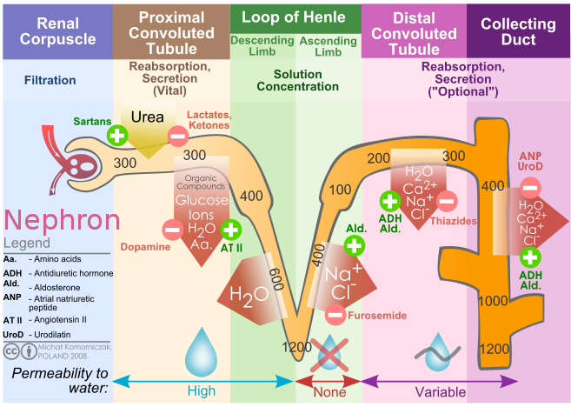
Importance
Molecular Weight

Slide 3
Abnormal Constituents
Glucose
Albumin
Acetone
Bile Salt

Slide 4
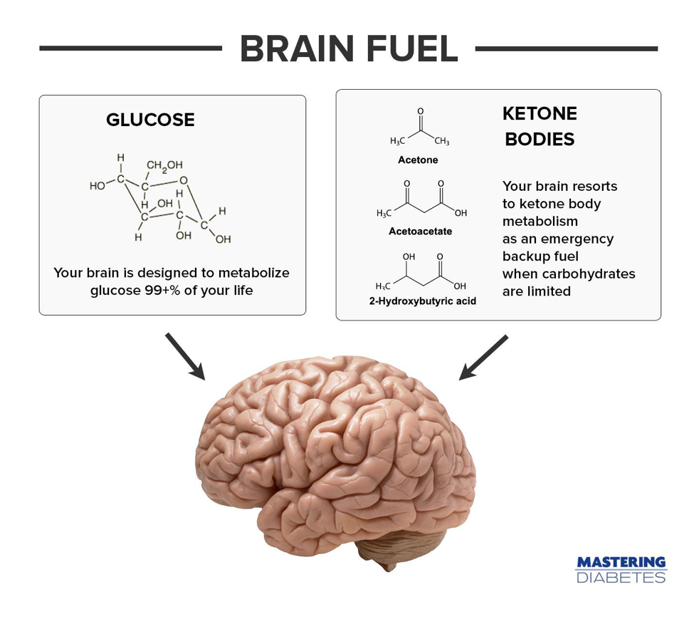
Glucose in Urine

Slide 5
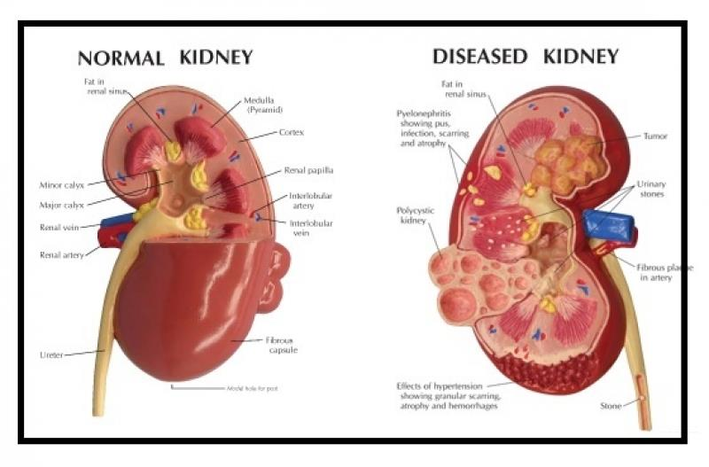
Albumin in Urine
High Molecular weight

Slide 6
Acetone in Urine
Water
Soluble
Excessive breakdown of fatty acids
Ketone Bodies
(Acetone, B-hydroxyl butyrate, and acetoacetate)
Uncontrolled Diabetes
Undiagnosed Diabetes
Unbalanced Diet

Slide 7
Bile Salt in Urine

Slide 8
Urine Report
Physical Properties
Chemical Reactions

Slide 9
Physical Properties
Color
Odor
Aspect
Appearance
PH
Specific Gravity

Slide 10
Color
Amber Yellow
Normal Condition
Can the Color be affected by certain conditions?
Physiological Condition | Pathological Condition
Cold Weather increases the urination which will cause the color to be pale yellow Rifampicin an antibiotic which will cause the urine to be red in color | Hepatitis A will cause the urine to be brownish yellow due to the presence of bilirubin (a liver pigment) Diabetes will cause the urine to be pale yellow due to the increased frequency of urination

Slide 11
Odor
Aromatic
Normal Condition
Can the odor be affected by certain conditions?
Physiological Condition | Pathological Condition
Due to a lab error as leaving the urine without quick handling will allow the bacteria to react with it producing ammonia like odor | Acetone in Urine = Sweet Apple like odor due to diabetes or un balanced diet

Slide 12
Aspect
No Deposits
Presence of deposits which will precipitate upon standing
Such as epithelial cells

Slide 13
Appearance
Clear
Turbid in case of Albumin

Slide 14
PH
Slightly Acidic

Slide 15
Specific Gravity

Slide 16
Specific Gravity
Normal Range | Accepted Range | Less than 1010
1010-1025 | 1000-1060 | Diabetes Insipidus

Slide 17
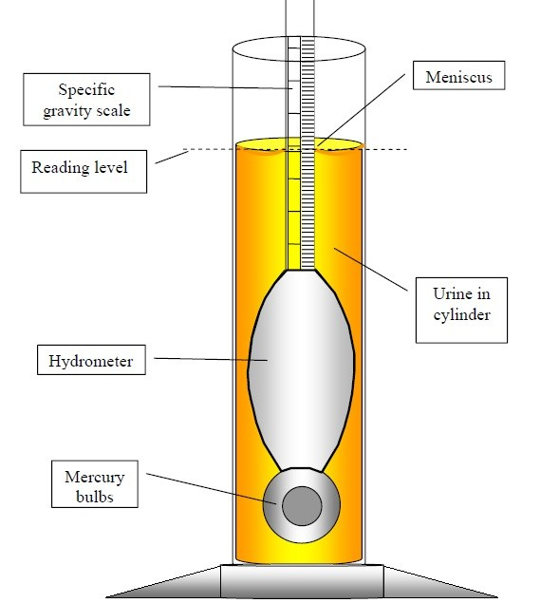
Specific Gravity
Reading + (Room Temperature-15)/3

Slide 18
Chemical
Reactions

Slide 19
Coagulation Test for Albumin | Fehling Test for Glucose
Heat 15 mls sample | 2 mls sample 1 ml FB 1ml FA Boil
White Coagulum | Red PPt

Slide 20
Hays Sulphur Test for Bile Salt
Half spatula sulpur 5 mls sample No Shaking
If the Sulphur sinks then it has Bile salts as they alter the surface tension, however if the Sulphur floats then the tension is intact and Bile salts are not present

Slide 21
Rothera’s Test for Acetone
3 ml Amonia 2 dps Na nitroprusside Vigorous shaking 3 spt Ammonium Sulphate 3 mls sample
Permanganate Color

Slide 22
Minerals

Slide 23
Classification of Minerals
Minerals
Macro-minerals
Micro-minerals
Needed in relatively large amounts.
Also called principal elements
Ex. Calcium, Phosphorus and Magnesium.
Needed in small amounts.
Also called trace elements.
Ex. Florine, Zinc and Iron.

Slide 24
Macro-minerals
Calcium
Functions of calcium:
Calcification of bones and teeth (enamel and dentine)
Promotes blood clotting by activating certain coagulation factors.
Regulate heart beats, muscle tone and muscle contraction.
Nerve conduction.
Mediator of hormone action.
Critical role in apoptosis.

Slide 25
Calcium
Regulation of plasma calcium level
Hypo-calcemia
Hyper-calcermia
Stimulates Parathyroid hormone (PTH) Calcium in blood by:
Urinary calcium excretion
intestinal absorption of calcium.
mobilization of calcium and phosphate from bones.
Activates vitamin D (calcitriol is the activated form of vit D)
Calcitriol will increase the Intestinal and the renal reabsorption of calcium
Calcitonin
Oppose PTH by:
Plasma calcium level
renal excretion of calcium
Intestinal absorption of calcium

Slide 26
Micro-minerals
Florine
Fluoride is taken into the enamel of teeth, making it harder and more resistant to decay.
Function:
Prevents dental caries by two mechanisms:
Formation of fluoroapatite which is resistant to bacterial attack.
Fluoride inhibits the glycolytic enzyme ―enolase‖, thus preventing bacterial fermentation in mouth.

