Slide 1
Entrepreneurship: Successfully Launching New Ventures
Sixth Edition, Global Edition
Chapter 2
Recognizing Opportunities and Generating Ideas
Notes:
If this PowerPoint presentation contains mathematical equations, you may need to check that your computer has the following installed:
1) MathType Plugin
2) Math Player (free versions available)
3) NVDA Reader (free versions available)

Slide 2
Learning Objectives
2.1 Explain the difference between opportunities and ideas.
2.2 Describe the three general approaches entrepreneurs use to identify opportunities.
2.3 Discuss the personal characteristics of entrepreneurs that contribute to their ability to recognize business opportunities.
2.4 Identify and describe techniques entrepreneurs use to generate ideas.

Slide 3
Introduction: Sector vs Industry
Sector - A sector is an area of the economy in which businesses share the same or a related product or service.
Industry- a group of firms that produces a similar product or service
The industry is served by upstream and downstream industries.
Also, each industry is composed of “segments”, and inside each segment there are “strategic groups”.

Slide 4
Understanding Industry Players
Analysis of the industry (sometimes focused on a specific segment or strategic groups:
Porter’s 5 forces:
Threat of new entrants
Rivalry among existing firms
Threat of substitute products
Bargaining power of buyers
Bargaining power of suppliers
Relative power of other stakeholders

Slide 5
Differences between ideas and opportunities
Opportunity refers to a favorable time or situation for doing something whereas an idea refers to a thought or suggestion about a possible course of action. An opportunity is a chance that an individual gains. Idea, on the other hand, is a plan.
Ideas are solutions to problems and are important providing creative spark for your business. Opportunities, on the other hand, are something (ideas, circumstances, situation) that can lead to a desirable and viable business. They may or may not originate from an idea. Opportunities have value.
If an individual has the necessary knowledge and skills, he can transform his/her idea into a business opportunity.

Slide 6
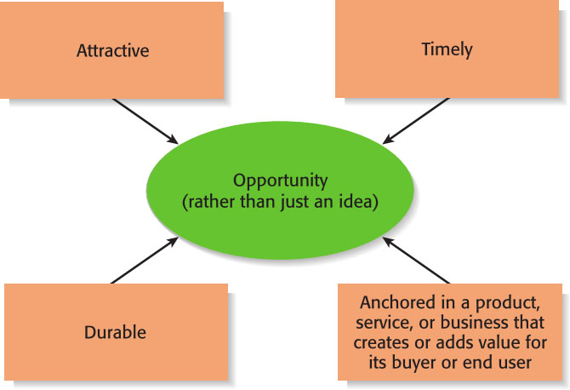
What is an Opportunity?
Four Essential Qualities of an Opportunity
An opportunity is a favorable set of circumstances that creates a need for a new product, service, or business.

Slide 7
Opportunity identification and assessment
Once you pick up the idea in mind, the idea can become an opportunity for business. Opportunity analysis is the process of deciding (based on a number of factors) whether an idea is a real market opportunity. A market opportunity is the one that:
Is realistic enough to be turned into a product or service; given the resources and technology at hand;
Meets the needs of customers, who are willing to pay to obtain the product/service;
Can be priced at a rate that can generate income and/or profit for investors and entrepreneurs.

Slide 8
Opportunity analysis should be done based on the following matrix
Demand
People are willing and able to buy the product and/or service. They need the product and they are able to pay for it. It is not enough that people like the product.
Innovation
The product/service should be new (first introduced mobile phone), or you have altered something in an existing product/service (thin laptops) or the process of manufacturing the product/service (McDelivery in 20 minutes rather than an hour).
Feasibility
A product or service is feasible to be offered to the market when the technology and resources at hand (financial and human resources) are adequate to launch the product/service.
External influences
Entrepreneurs should look at the external factors that may affect their product/service offerings. Key issues are summarized in the STEEP technique: Social, Technological, Economic, Environmental, and Political/legal changes.

Slide 9
Three Approaches to Identify an Opportunity
Follow economic, political, technological, and social trends.
Observing challenges encounter everyday.
Consumers needs and wants are not met or products are not readily available.

Slide 10
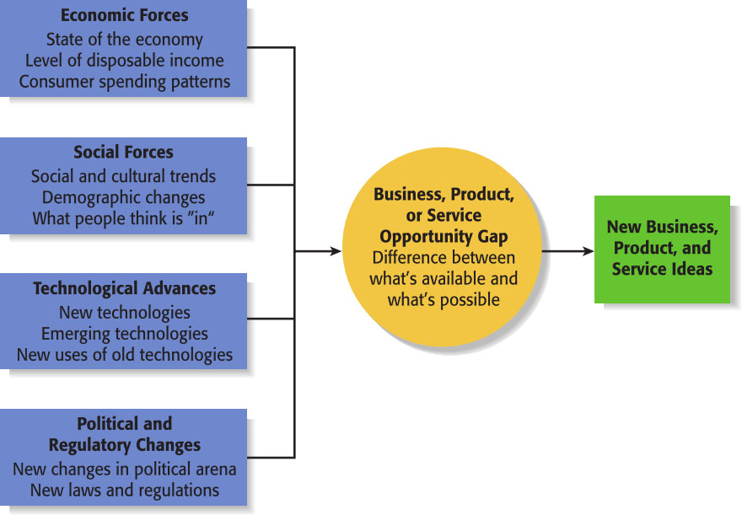
Observing Environmental Trends (for seizing opportunities) suggesting Business, Product, or Service Opportunity Gaps
Environmental Trends

Slide 11
First Approach: Observing Environmental Trends
Trends create opportunities for entrepreneurs to pursue.
The most important trends are:
Economic forces
Social forces
Technological advances
Political and regulatory changes
It’s important to be aware of changes in these areas.

Slide 12
Trend 1: Economic Forces
Economic trends help determine areas that are ripe for new start-ups and areas that start-ups should avoid.
Example of Economic Trend Creating a Favorable Opportunity
A weak economy favors start-ups that help consumers save money.
An example is Gas Buddy.com, a company started to help consumers save money on gas.

Slide 13
Trend 2: Social Forces
Social trends alter how people and businesses behave and set their priorities. These trends provide opportunities for new businesses to accommodate the changes.
Examples of Social Trends
Aging of the population.
The increasing diversity of the population.
Millennials entering the workforce.
Growth in the use of mobile devices.
An increasing focus on health and wellness.

Slide 14
Trend 3: Technological Advances
Advances in technology frequently create business opportunities.
Examples of Entire Industries that Have Been Created as the Result of Technological Advances
Computer industry
Internet
Biotechnology
Digital photography

Slide 15
Trend Four: Political and regulatory changes
New changes in political arena
New laws and regulations

Slide 16
Second Approach: Solving a Problem
Solving a Problem
Sometimes identifying opportunities simply involves noticing a problem and finding a way to solve it.
These problems can be pinpointed through observing trends and through more simple means, such as intuition, serendipity, or chance.
Many companies have been started by people who have experienced a problem in their own lives, and then realized that the solution to the problem represented a business opportunity.

Slide 17
Second Approach: Solving a Problem
Specific Example:
Sometimes people aren’t able to access energy to recharge their smartphones for a period of time. A number of companies have solved this problem in innovative ways. An example is the $70 Eton Boost Turbin 2000, which is a device that weighs less than four ounces. It combines a battery with a hand crank that provides enough power to fully charge a typical smartphone.
Other examples:
Handover, By2olak, Vezeeta/Tabibi, Super Mama, and Shezlong.

Slide 18
Third Approach: Finding Gaps in the Marketplace
Gaps in the Marketplace
A third approach to identifying opportunities is to find a gap in the marketplace.
A gap in the marketplace is often created when a product or service is needed by a specific group of people but doesn’t represent a large enough market to be of interest to mainstream retailers or manufacturers.

Slide 19
Third Approach: Finding Gaps in the Marketplace
Product gaps in the marketplace represent potentially viable business opportunities.
Specific Example
Tish Cirovolo realized there were no guitars on the market made specifically for females. To fill this gap, she started Daisy Rock Guitars, a company that makes guitars just for women and girls. Daisy Rock guitars are stylish, come in feminine colors, and incorporate design features that accommodate a woman’s smaller hand and build.

Slide 20
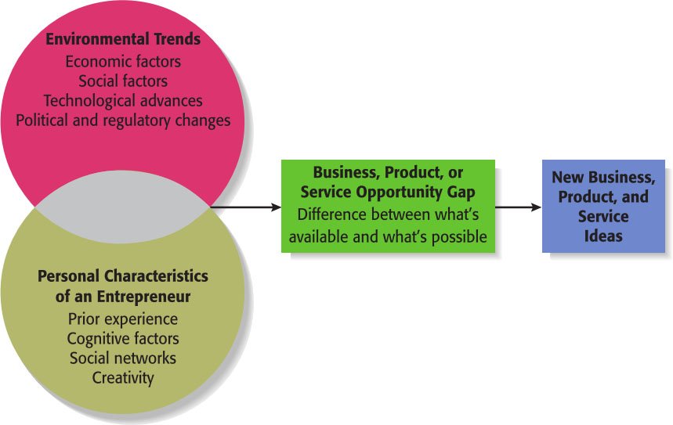
Full View of the Opportunity Recognition Process
Depicts the connection between an awareness of emerging trends and the personal characteristics of the entrepreneur The Opportunity Recognition Process

Slide 21
Personal Characteristics of the Entrepreneur
Characteristics that tend to make some people better at recognizing opportunities than others
Prior Industry Experience
Cognitive Factors
Social Networks
Creativity

Slide 22
Creativity
Creativity
Creativity is the process of generating a novel or useful idea.
Opportunity recognition may be, at least in part, a creative process.
For an individual, the creative process can be broken down into five stages, as shown on the next slide.

Slide 23
Creativity
Five Steps to Generating Creative Ideas

Slide 24
Techniques for Generating Ideas
Focus Groups
Brainstorming
Library and Internet Research

Slide 25
Focus Groups
Focus groups involve a group of people who are familiar with a topic, are brought together to respond to questions, and who are able to shed light on an issue through the give-and-take nature of group discussions.
They work best as a follow-up to brainstorming, when the general idea for a business has been formulated but further refinement of the idea is needed.

Slide 26
Brainstorming
Is the process of generating several ideas about a specific topic.
A brainstorming “session” typically involves a group of people, and should be targeted to a specific topic.
Rules for a brainstorming session:
No criticism.
Freewheeling is encouraged.
The session should move quickly.
Leap-frogging is encouraged.

