Slide 1
Entrepreneurship: Successfully Launching New Ventures
Sixth Edition, Global Edition
Chapter 3
Feasibility Analysis
Notes:
If this PowerPoint presentation contains mathematical equations, you may need to check that your computer has the following installed:
1) MathType Plugin
2) Math Player (free versions available)
3) NVDA Reader (free versions available)

Slide 2
Learning Objectives (1 of 2)
3.1 Explain what a feasibility analysis is and why it’s important.
3.2 Describe a product/service feasibility analysis, explain its purpose, and discuss the two primary issues that a proposed business should consider in this area.
3.3 Describe an industry/market feasibility analysis, explain its purpose, and discuss the two primary issues to consider when completing this analysis.

Slide 3
Learning Objectives (2 of 2)
3.4 Explain what an organizational feasibility analysis is and its purpose and discuss the two primary issues to consider when completing this analysis.
3.5 Describe what a financial feasibility analysis is, explain its importance, and discuss the most critical issues to consider when completing this analysis.
3.6 Describe a feasibility analysis template and explain when it is important for entrepreneurs to use this template.

Slide 4
What Is Feasibility Analysis?
Feasibility Analysis
Feasibility analysis is the process of determining whether a business idea is viable.
It is the preliminary evaluation of a business idea, conducted for the purpose of determining whether the idea is worth pursuing.

Slide 5
When to Conduct a Feasibility Analysis
Timing of Feasibility Analysis
The proper time to conduct a feasibility analysis is early in thinking through the prospects for a new business.
The thought is to screen ideas before a lot of resources are spent on them.
Components of a Properly Conducted Feasibility Analysis
A properly conducted feasibility analysis includes four separate components, as discussed in the following slides.

Slide 6
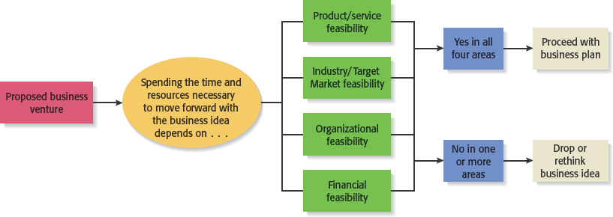
Feasibility Analysis
Figure 3.1 Role of Feasibility Analysis in Developing Successful Business Ideas

Slide 7
Forms of Feasibility Analysis
Product/Service Feasibility
Industry/Target Market Feasibility
Organizational Feasibility
Financial Feasibility

Slide 8
Outline for a Comprehensive Feasibility Analysis
Table 3.1 Feasibility Analysis
Part 1: Product/Service Feasibility
Product/service desirability
Product/service demand
Part 2: Industry/Target Market Feasibility
Industry attractiveness
Target market attractiveness
Part 3: Organizational Feasibility
Management prowess
Resource sufficiency
Part 4: Financial Feasibility
Total start-up cash needed
Financial performance of similar businesses
Overall financial attractiveness of the proposed venture
Overall Assessment

Slide 9
Product/Service Feasibility Analysis (1 of 2)
Purpose
Is an assessment of the overall appeal of the product or service being proposed.
Before a prospective firm rushes a new product or service into development, it should be sure that the product or service is what prospective customers want.

Slide 10
Product/Service Feasibility Analysis (2 of 2)
Components of product/service feasibility analysis
Product/Service Desirability
Product/Service Demand

Slide 11
Product/Service Desirability (1 of 3)
First, ask the following questions to determine the basic appeal of the product or service.
Does it make sense? Is it reasonable? Is it something consumers will get excited about?
Does it take advantage of an environmental trend, solve a problem, or take advantage of a gap in the marketplace?
Is this a good time to introduce the product or service to the market?
Are there any fatal flaws in the product or service’s basic design or concept?

Slide 12
Product/Service Desirability (2 of 3)
Second, Administer a Concept Test
A concept statement should be developed.
A concept statement is a one-page description of a product or service idea that is distributed to people who are asked to provide feedback on the potential of the idea.
The feedback will hopefully provide the entrepreneur:
A sense of the viability of the product or service idea.
Suggestions for how the idea can be strengthened or “tweaked” before proceeding further.

Slide 13
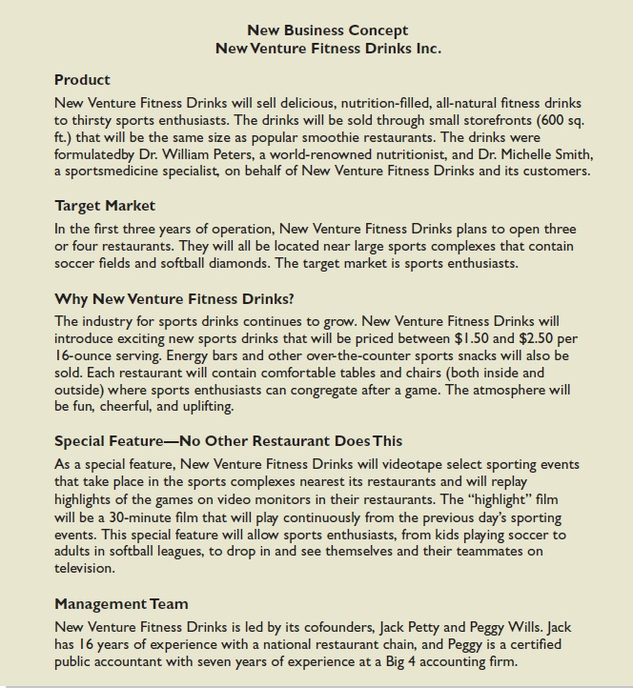
Product/Service Desirability (3 of 3)
Figure 3.2 New Venture Fitness Drinks’ Concept Statement

Slide 14
Product/Service Demand (1 of 10)
There are three steps to assessing product/service demand.
Step 1: Talking Face-to-Face with Potential Customers
Step 2: Using Online Tools
Step 3: Library, Internet and Gumshoe Research

Slide 15
Product/Service Demand (2 of 10)
Step 1: Talking Face-to-Face with Potential Customers
The only way to know if your product or service is what people want is by talking to them.
The idea is to gauge customer reaction to the general concept of what you want to sell, and then tweak, revise, and improve on the idea based on the feedback.
In some cases, talking with potential customers will cause an entrepreneur to abandon an idea.
Entrepreneurs are often surprised to find that a product idea they think solves a problem gets lukewarm reception when they talk to actual customers.

Slide 16
Product/Service Demand (3 of 10)
Step 2: Utilizing Online Tools
The second way to assess demand is to utilize online tools to gauge reaction from potential customers.
Online tools include the following:
Administrating surveys
Querying Q&A sites
Utilizing Google Trends
Purchasing Google AdWords to direct users to landing pages to see how many people request additional information.

Slide 17
Product/Service Demand (4 of 10)
Surveys and Q&A Sites
Surveys can be generated and easily administered via web sites like Survey Monkey.
Surveys are most effective in validating what you’ve learned from face-to-face interviews rather than collecting initial data.
Q&A Sites, such as Quora and Bright Journey, can be helpful in assessing product demand.
You might pose a question on a Q&A site such as “Does Chicago need better food delivery services?” The responses may provide insight about demand for food delivery services in Chicago.

Slide 18
Product/Service Demand (5 of 10)
Google Trends
Allows you to enter a search term (such as skiing or running) to see if the term is trending upwards or downwards in Google search queries.
An upward trajectory may indicate strong consumer interest, while a downward trajectory may indicate that consumer interest is waning.

Slide 19
Product/Service Demand (7 of 10)
Step 3: Library, Internet and Gumshoe Research
The third way to assess the demand for a product or service idea is to conduct library, Internet, and gumshoe research.

Slide 20
Industry/Target Market Feasibility Analysis (1 of 2)
Purpose
Is an assessment of the overall appeal of the industry and the target market for the proposed business.
An industry is a group of firms producing a similar product or service.
A firm’s target market is the limited portion of the industry it plans to go after.

Slide 21
Industry/Target Market Feasibility Analysis (2 of 2)
Components of industry/target market feasibility analysis
Industry Attractiveness
Target Market Attractiveness

Slide 22
Industry Attractiveness (1 of 2)
Industries vary in terms of their overall attractiveness.
In general, the most attractive industries have the characteristics depicted on the next slide.
Particularly important—the degree to which environmental and business trends are moving in favor rather than against the industry.

Slide 23
Target Market Attractiveness
The challenge in identifying an attractive target market is to find a market that’s large enough for the proposed business but is yet small enough to avoid attracting larger competitors.
Assessing the attractiveness of a target market is tougher than assessing the attractiveness of an entire industry.
Often, considerable ingenuity must be employed to find information to assess the attractiveness of a specific target market.

Slide 24
Organizational Feasibility Analysis (1 of 2)
Purpose
Is conducted to determine whether a proposed business has sufficient management expertise, organizational competence, and resources to successfully launch a business.
Focuses on non-financial resources (financial resources are considered later)

Slide 25
Financial Feasibility Analysis (1 of 2)
Purpose
Is the final component of a comprehensive feasibility analysis.
A preliminary financial assessment is sufficient.

Slide 26
Financial Feasibility Analysis (2 of 2)
Components of financial feasibility analysis
Total Start-Up Cash Needed
Financial Performance of Similar Businesses
Overall Financial Attractiveness of the Proposed Venture

Slide 27
Total Start-Up Cash Needed
The first issue refers to the total cash needed to prepare the business to make its first sale.
An actual budget should be prepared that lists all the anticipated capital purchases and operating expenses needed to generate the first $1 in revenues.
The point of this exercise is to determine if the proposed venture is realistic given the total start-up cash needed.

Slide 28
What advantages can an entrepreneur who buys a business gain over one who starts a business “from scratch”?
The advantages of buying an existing business may include:
A Successful Existing Business May Continue to Be Successful: Buying a thriving business increases the likelihood of success building upon an established customer base, supplier relationships, and business system. The new owner benefits from these important business factors already in place.
An Existing Business May Already Have the Best Location: If the location of a business is critical to its success, it may be wise to purchase a business that is already strategically located.
Employees and Suppliers are in Place: Experienced employees enable a company to continue to earn money while a new owner learns the business. Existing vendors can continue to supply the business while the new owner investigates the products and services of others.

Slide 29
What advantages can an entrepreneur who buys a business gain over one who starts a business “from scratch”?
Equipment Is Installed and Productive Capacity Is Known: The buyer does not have to invest in equipment, and the previous owner may have established an efficient production operation. Thus, the new owner can use these savings in time and money to improve and expand the existing equipment and procedures.
Inventory Is in Place and Trade Credit Is Established: Establishing the right amount of inventory can be costly. If there is too little inventory, customer demand cannot be satisfied. If too much is available, excessive capital is tied up, costs are increased, and profits decrease. There is a tremendous advantage if previous owners have established a balance in inventory. In addition, a proven track record gives the new owner leverage in negotiating credit concessions.
A Turnkey Business: the buyer gets a business that is already generating cash and perhaps profits as well.
Experience of Previous Owner: If the previous owner is around, the new owner can benefit from his/her expertise. Even if the owner is not present, business records can guide the new owner.

