Slide 1
Lecture 4: Protein Metabolism By: Dr Samar Elkhateeb lecturer of biochemistry and genetics Smaged@msa.edu.eg
Biochemistry Department (SMS236z)

Slide 2
Our body needs proteins for growth and maintenance of tissues.
Yet, your body’s proteins are in a constant state of turnover.
Under normal circumstances, your body breaks down the same amount of protein that it uses to build and repair tissues. Other times, it breaks down more protein than it can create, thus increasing your body’s needs.
This typically happens during illness, pregnancy ,breastfeeding or while recovering from an injury or surgery, older adults and athletes require more protein as well.

Slide 3
Amino acids & protein chemistry
Amino acids are the building blocks of the proteins.
There are about 300 amino acids occur in nature. Only 20 (genetically coded amino acids) of them occur in mammalian protein.
Other amino acids are found in a number of natural proteins

Slide 4
Structure of amino acids:
Each amino acid has the following 4 groups or atoms attached to alpha (α) carbon atom:
Amino group (-NH2)
Carboxyl group (-COOH)
Hydrogen atom (-H)
Side chain or radical group (-R)

Slide 5
Biological importance of Amino Acids
1.Building blocks of peptides and proteins.
2.As precursors of many biologically important molecules. Examples:
Tyrosine is the precursor of the hormone thyroxine and the skin pigment melanin.
Tryptophan is the precursor of the vitamin nicotinic acid.
3.Involved in many metabolic pathways such as in gluconeogenesis where it is involved in glucose synthesis.

Slide 6
Chemical classification of Amino acids
According to the amino acid side chain (R radical), they are classified into 20 amino acid.
Aliphatic nonpolar side chain
Aromatic side chain
Hydroxyl-containing side chain
Sulfur-containing side chain
Acidic side chain
Basic side chain
Amidic side chain
Imino acid (Side chain and α -amino group form a ring structure (Pyrrolidine ring). )

Slide 7
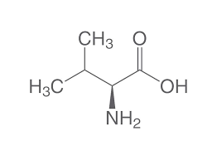
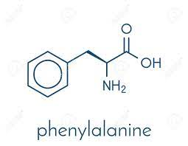
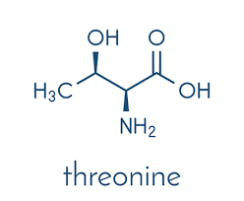
Aliphatic nonpolar side chain
Glycine( Gly ) ,Alanine Ala (A), Valine Val (V), Leucine Leu (L) ,
Isoleucine Ile (I)
Aromatic side chain
Phenylalanine Phe (F), Tyrosine Tyr (Y) ,Tryptophan Try (w)
Hydroxyl-containing side chain
Serine Ser (s), Threonine Thr (T)

Slide 8
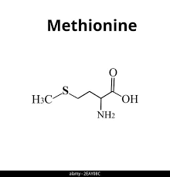
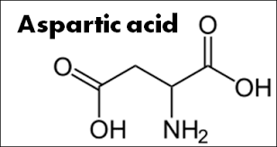
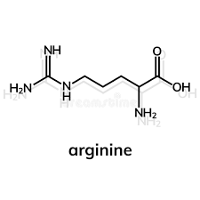
Sulfur-containing side chain
Methionine Met (M), Cystiene Cys (C)
Acidic side chain
Aspartic acid Asp (D) , Glutamic acid Glu (E)
Basic side chain
Lysine Lys (K), Arginine Arg (R), Histidine His (H)

Slide 9
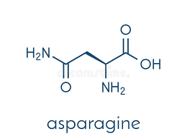
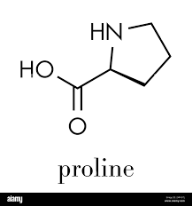
Amidic side chain
Asparagine Asn (N) , Glutamine Gln (Q)
Imino acid
Proline Pro (P)

Slide 10
Amino acids with Non polar side chains
Glycine, Alanine, Valine, Leucine, Isoleucine, Proline, Methionine, Phenylalanine, Tryptophan General properties: Present in proteins that are located in a hydrophobic environment, such as membrane, where the non-polar R group are found on the surface of the protein, facing and interacting with the lipid content. This plays an important role in stabilizing protein structure.

Slide 11
Amino acids with Polar, uncharged side chains
Serine, Threonine, tyrosine: contain OH group, which makes these amino acids much more hydrophilic and reactive than their hydrophobic analogs. They can participate in hydrogen bond formation.
Asparagine and glutamine: Contain an amide group that can participate in hydrogen bond.
Cysteine is structurally similar to serine but contains a sulfhydryl, or thiol (-SH), group in place of the hydroxyl (-OH) group

Slide 12
Charged Amino acids:
Acidic AA
Aspartate & glutamate, They have an extra acidic group in the side chain.
Basic AA
Lysine, Arginine & Histidine ,They have an extra basic group in the side chain
(These charges on both acidic and basic amino acids are important in the formation of secondary structures of proteins. They are important during the enzymatic catalysis of biochemical reactions as well)

Slide 13
Levels of Protein Structure
Primary structure
Secondary structure
Tertiary Structure
Quaternary Structure

Slide 14
Primary structure:
Peptide bond:
• Amide bond between α-COO- and α-NH3 + is formed by condensation.
• Not broken by heat or urea (un folding).
• Can be broken by strong acids or bases or by proteolytic enzymes.

Slide 15
Secondary Structure
It is defined as the folding of the backbone of the polypeptide chain by weak hydrogen bonds between carbonyl oxygen and amide hydrogen
• This produces the alpha helix (Spiral structure)and beta sheets and beta turn. (extended beta strands (parallel or antiparallel))

Slide 16
Tertiary Structure
Folding of basic units (domain) to form a final arrangement of a single polypeptide chain (monomeric protein).
Domain is a functional three dimensional structure unit of a polypeptide.
Tertiary structure is stabilized by a variety of interactions (bond formations) among side chain groups of amino acids.
1.Hydrogen bonds among polar side chains
2. Ionic bonds between charged R groups (basic and acidic amino acids.
3. Hydrophobic interactions among hydrophobic (non polar) R groups.
4. Disulfide bridges between the sulfhydryl groups (SH) of cysteine monomers

Slide 17
Quaternary Structure
Quaternary structure results from the assembly (combination) of two or more polypeptide subunits held together by non-covalent interaction like H-bonds, ionic or hydrophobic interactions.
Examples of protein having quaternary structure:
Insulin: two polypeptide chains (dimeric)
Collagen: three polypeptide chains (trimeric)
Hemoglobin: four polypeptide chains (tetrameric)

Slide 18
Amino Acids Catabolism
Amino acids catabolism involves:
Removal of ɑ-amino group:
Transamination
Deamination ₋ Oxidative ₋ Non oxidative ₋ Hydrolytic
Transdeamination
Breakdown of carbon skeleton

Slide 19
I) TRANSAMINATION
It is the transfer of amino group from α-amino acid to α-keto acid to form a new α-amino acid and a new α-keto acid
Enzymes catalyze transamination reaction called transaminases (or amino transferases).
All transaminases utilize pyridoxal phosphate (PLP) (active form vitamin B6) as the coenzyme in the transamination reactions.
Role of PLP in transamination reactions: PLP acts as an intermediate carrier of amino group.
All transamination reactions are reversible.

Slide 20
I) TRANSAMINATION cont,
Among all transaminases, 2 are present in most mammalian tissues and they are of clinical importance. These are:
ALT and AST
All transaminases are present either in cytoplasm or in both cytoplasm and mitochondria of most tissues.

Slide 21
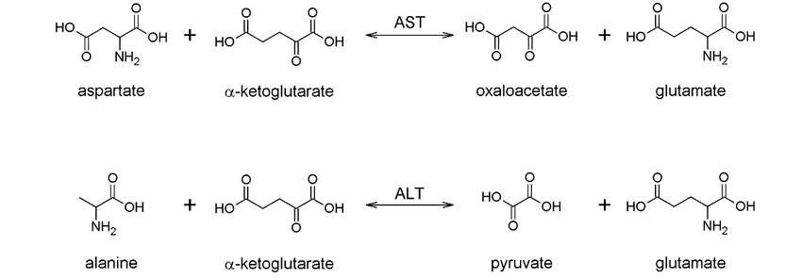
1- Alanine transaminase (ALT):
ALT also called glutamate pyruvate transaminase (GPT).
ALT is present in the cytosol of the cells.
ALT is an enzyme that catalyzes the transfer of amino group from Alanine to α-ketoglutarate to form glutamate and pyruvate. The reaction is reversible.

Slide 22
2- Asparatate transaminase (AST):
AST also called glutamate oxaloacetate transaminase (GOT).
AST is present in the cytosol and mitochondria of the cells.
AST is an enzyme that catalyzes the transfer of amino group from Aspartate to α-ketoglutarate to form glutamate and oxaloacetate. The reaction is reversible.

Slide 23
Diagnostic Importance Of Transaminases (ALT & AST)
Transaminases are normally intracellular enzymes.
The presence of elevated levels of transaminases in the blood indicates damage to cells producing these enzymes.
This occurs in certain diseases:
Elevated levels of both ALT and AST indicate possible damage of liver cells with subsequent escape of hepatic enzymes into blood.
An elevated level of AST only suggests damage to
heart muscle (myocardial infarction)
skeletal muscle
kidney.

Slide 24
II) Deamination
It is the removal of amino group from amino acids in the form of ammonia (NH3 ).
Deamination mostly occurs in liver and kidney.
Types of Deamination
Oxidative
Non-Oxidative
Hydrolytic

Slide 25
A- Oxidative deamination:
By oxidative deamination reaction, both oxidation (removal of hydrogen) and deamination (removal of ammonia) occur together.
Examples: 1- Glutamate dehydrogenase.

Slide 26
B- Non-oxidative deamination:
This occurs for hydroxy containing amino acids. Examples: serine and threonine without removal of hydrogen (non-oxidative).
Its coenzyme is pyridoxal phosphate.

Slide 27
C- Hydrolytic deamination:
This occurs for glutamine and asparagine.
Both are hydrolytically deaminated by glutaminase and asparaginase respectively.
Glutaminase enzyme is present in kidney. It produces ammonia, which is used in regulation of acid base balance by kidney.

Slide 28
AMMONIA
Ammonia is toxic substance especially for CNS.
Any ammonia formed in the peripheral tissue must be moved to the liver to be converted into urea. This maintains ammonia at low level in the circulating blood.

Slide 29
Transport of ammonia to liver:
Two mechanisms are available in humans for the transport of ammonia from the peripheral tissues to the liver for its ultimate conversion to urea (Glutamine and Glucose-Alanine cycle)
The first transport mechanism: Glutamine: Glutamine synthetase combines ammonia with glutamate to form glutamine. Glutamine is transported in the blood to the liver where it is cleaved by glutaminase to produce glutamate and free ammonia.

Slide 30
Transport of ammonia to liver cont.
The second transport mechanism:
Glucose-Alanine cycle:
Pyruvate produced is transaminated to form Alanine.
Alanine is transported by the blood to the liver, where it is converted to pyruvate, again by transamination.

Slide 31
Urea
Urea (H2N-CO-NH2) is the main end product of protein (amino acids) metabolism.
Urea formation is the pathway by which liver can convert toxic ammonia into non-toxic urea.

Slide 32
Ammonia Intoxication
Excess ammonia is toxic to the central nervous system➔ ammonia intoxication or hyperammonemia Blood contain traces of ammonia: 10-110 µg/dl.
Symptoms of hyperammonemia:
Slurred speech.
Blurred vision.
Vomiting
Coma & death

Slide 33
Types and causes of hyperammonemia
Acquired | Inherited
a) Liver cirrhosis by bilharziasis, alcoholism, hepatitis or biliary obstruction. b) Liver cell failure. | Result from genetic deficiency of one or more of 5 enzymes involved in urea cycle.

Slide 34
Metabolic classification: Based upon the fate of amino acid inside the body.
Ketogenic: This amino acid can be metabolized to acetoacetate or one of its precursor amino acid
Mixed amino acids: Those amino acids can be metabolized to both glucose & ketone bodies
Glucogenic amino acids: Those amino acids can be metabolized to glucose (pyruvate or one of intermediates of kreb’s cycle)

Slide 35
Conversion of amino acids to specialized products
1. Glycine ➔ creatine, porphyrines, purines, Glutathion.
2. Arginine ➔ creatine, nitric oxide (vasodilator).
3. Histidine ➔ histamine.
4. Tryptophan ➔ serotonin, niacin, melatonin.
5. Tyrosine ➔ catecholamines, melanin, T3&T4 (thyroid hormones).
6. Aspartate ➔ purines and pyrimidines.
7. Glutamine ➔ purines and pyrimidines.
8. Glutamate ➔ Gamma-aminobutyric acid (GABA)
9. Lysine ➔ carnitine

Slide 36
1- Catecholamines
These are dopamine, epinephrine and norepinephrine.
Function of catecholamines:
Neurotransmitter
Regulation of metabolism (stimulate glycogenolysis and lipolysis).
Increase cardiac output and blood pressure.

Slide 37
1- Catecholamines cont.
Dopamine. Dopamine is a neurotransmitter, when you find yourself craving something sugary in the candy aisle, that’s dopamine at work.
Dopamine’s roles spread far and wide, including:
Motor control
Emotions (pleasure or dislike)
Thought-processing
A dopamine imbalance can lead to a loss of motor control (such as Parkinson’s disease), addiction, ADHD, and schizophrenia.
Epinephrine and norepinephrine. These two hormones work together in stressful situations to increase blood flow throughout your body. Additionally, they break down fat and increase blood sugar (glucose) levels to give your body more energy.

Slide 38
2- Melanin pigments
Melanins are pigments present in many tissues particularly in the eye, iris, hair and skin.
Melanins are synthesized to protect underlying cells from the harmful effects of sun lights.

Slide 39
4- Histamine
Histamine is derived from histidine by decarboxylation catalyzed by histidine decarboxylase and PLP.
Functions of histamine:
Vasodilator.
Mediates cellular responses including allergic and inflammatory reactions.
Contraction of smooth muscle of bronchi.
Stimulation of gastric secretion.
Neurotransmitter.

