Slide 1



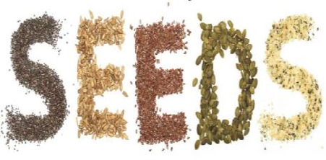
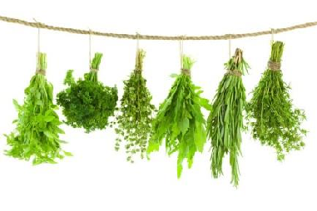


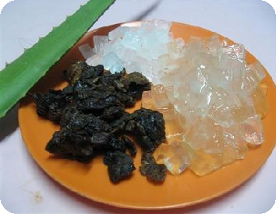
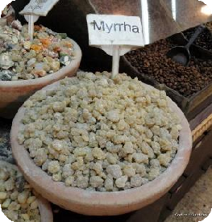



Pharmacognosy PHG112
Lab

Slide 2



Faculty of
Pharmacy

Slide 3
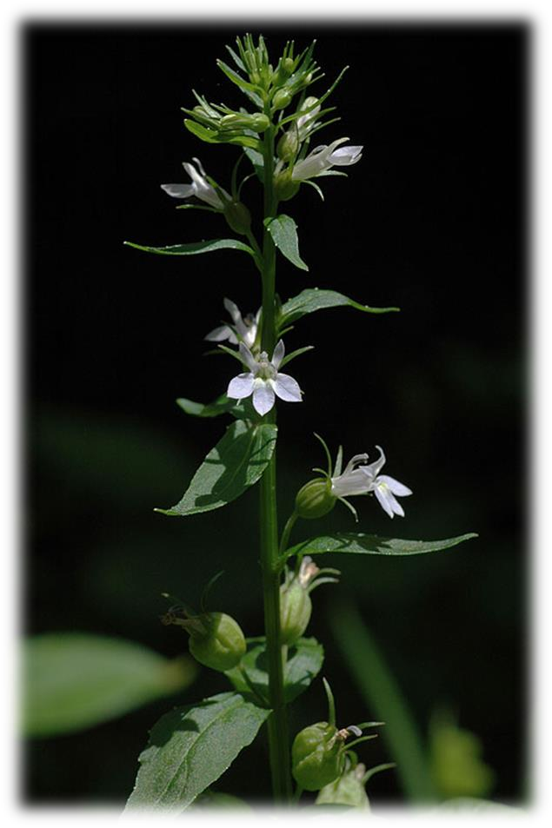
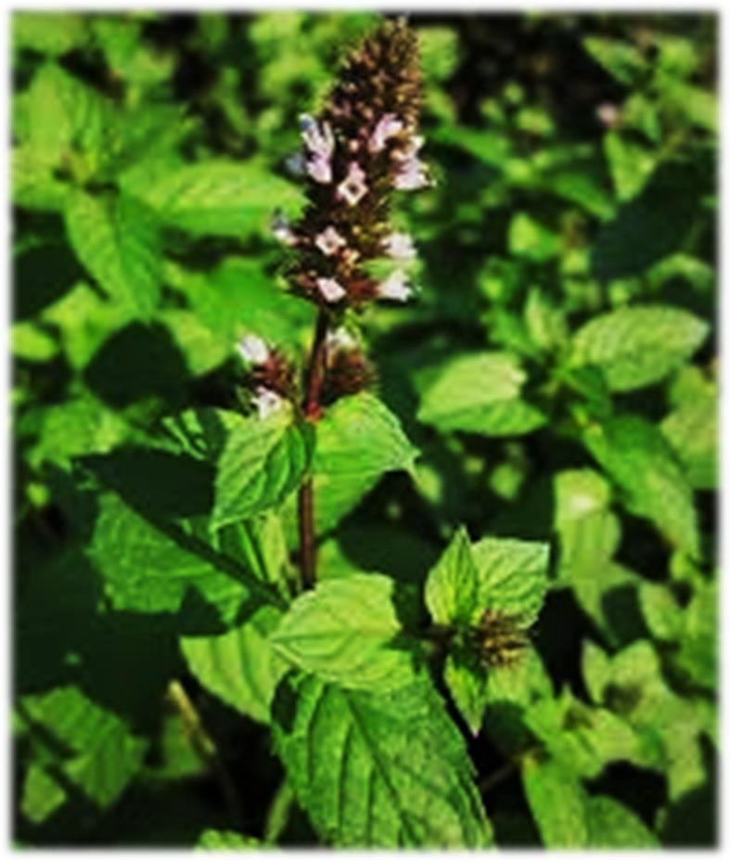
HERBS

Slide 4






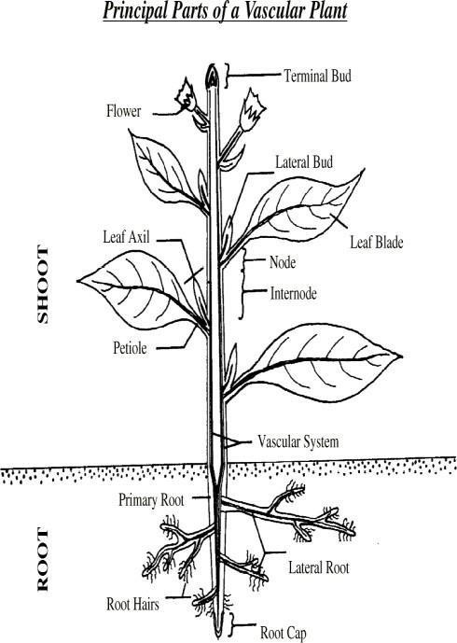
HERBS( Herba )
What is Herb?
In Pharmacognosy
Herb is a drug composed usually of the tender parts of the plant axis.
(the stem + leaves +flowers + fruits).

Slide 5
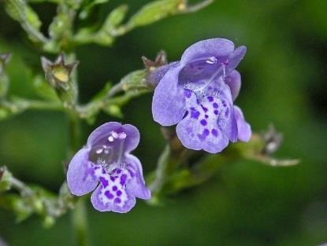
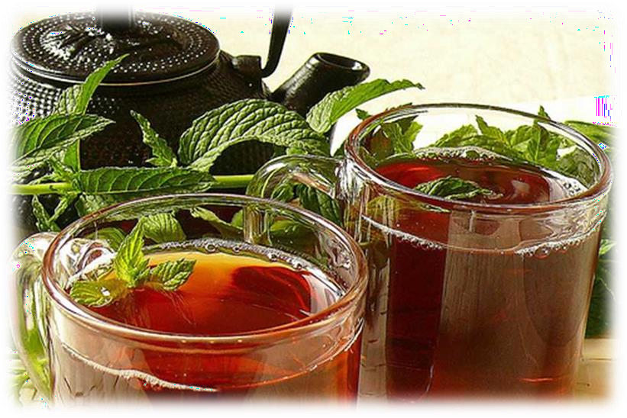
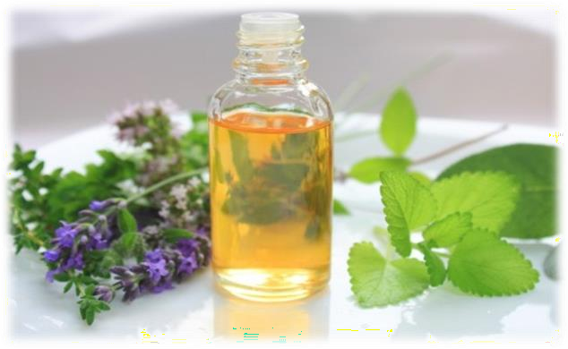
Peppermint

Slide 6
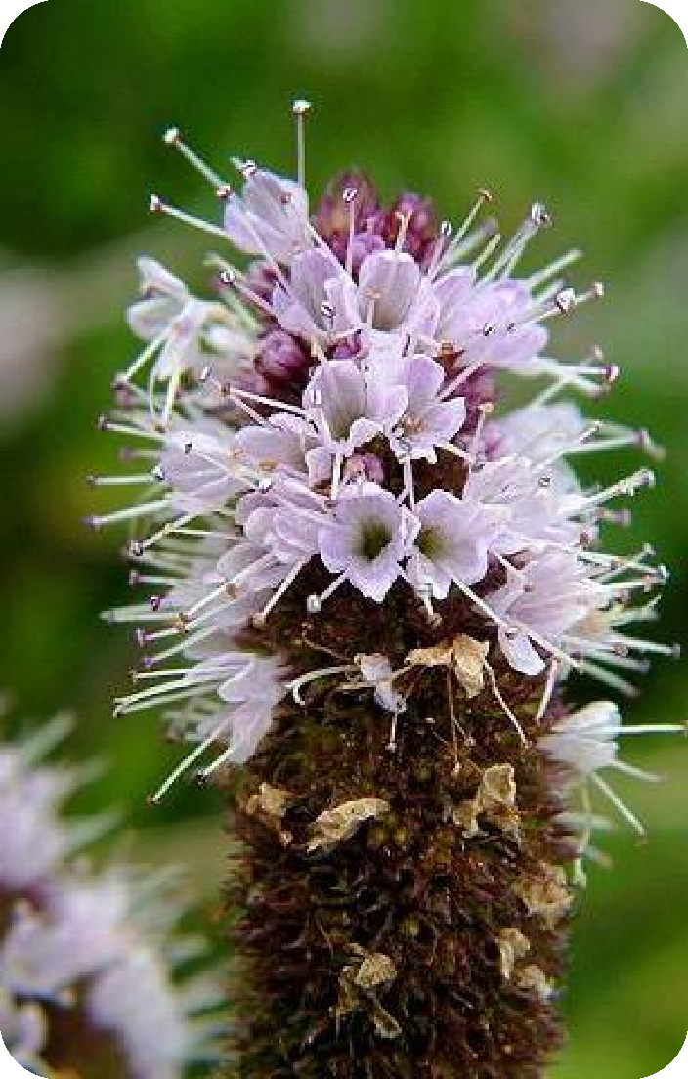
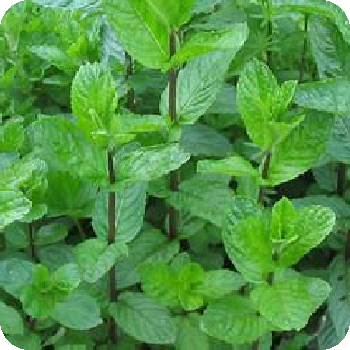


Origin:
Dried leaves and flowering tops
of Mentha piperita, F. Labiatae (Lamiaceae)

Slide 7
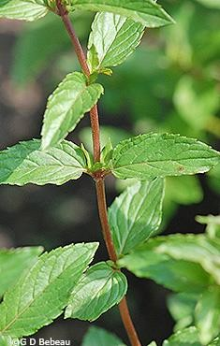
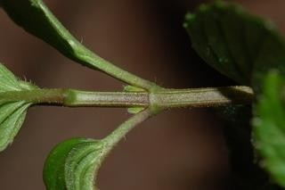
Morphology:
1- Stem
Quadrangular1-3 mm thick Green to dark purple tinge
Why???

Slide 8
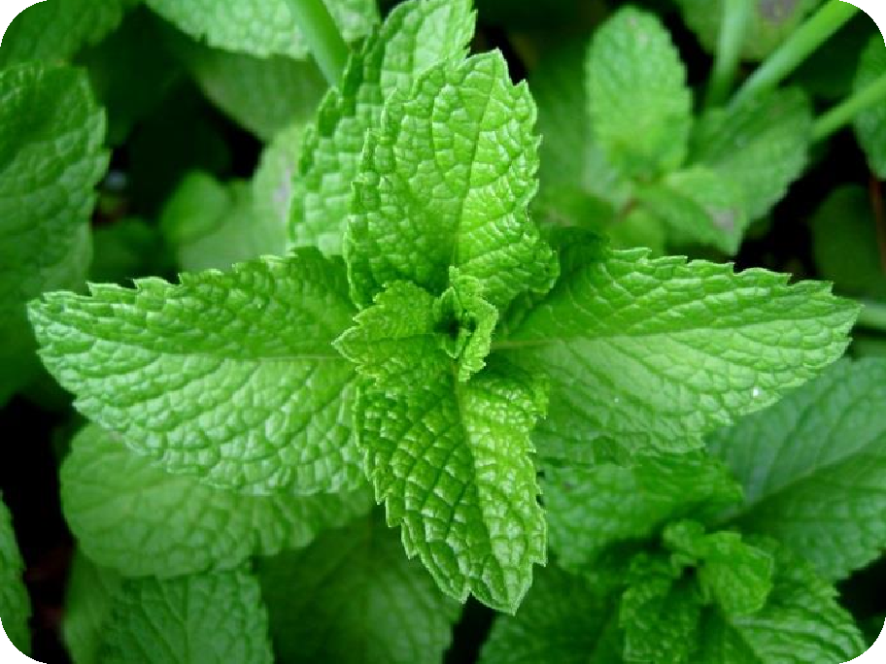
Morphology: 2- Leaves
Ovate, lanceolate, petiolate , opposite decussate with dark green, nearly glabrous upper surface and light green hairy lower surface

Slide 9
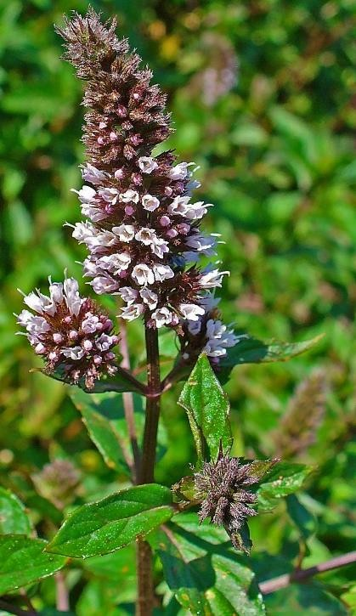
Morphology:
3- Flowers
Small Purple
Zygomorphic
Bilabiate

Slide 10

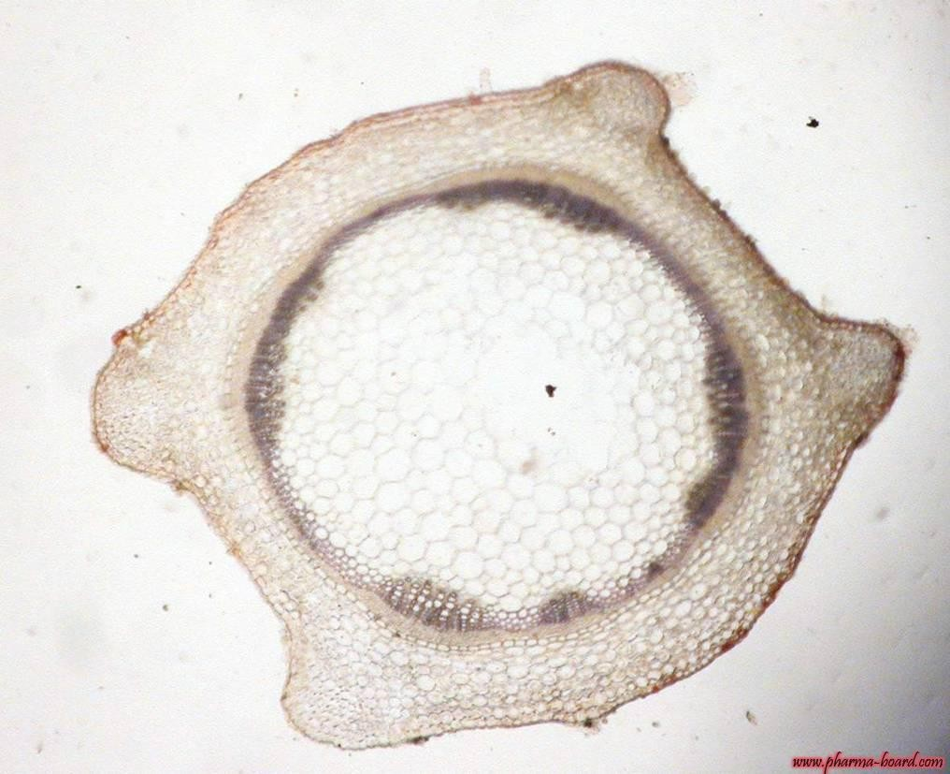

T.S in stem:
Vascular bundles
collenchyma
epidermis
Pith
endodermis

Slide 11
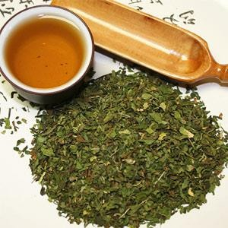
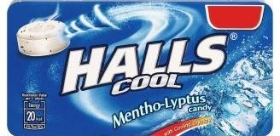
Physical characters:
Condition: Fine powder.
Colour: Olive Green. Odor: Aromatic.
Taste: Aromatic followed by cold sensation

Slide 12

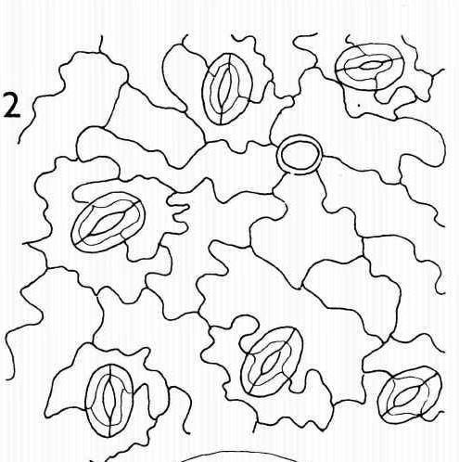
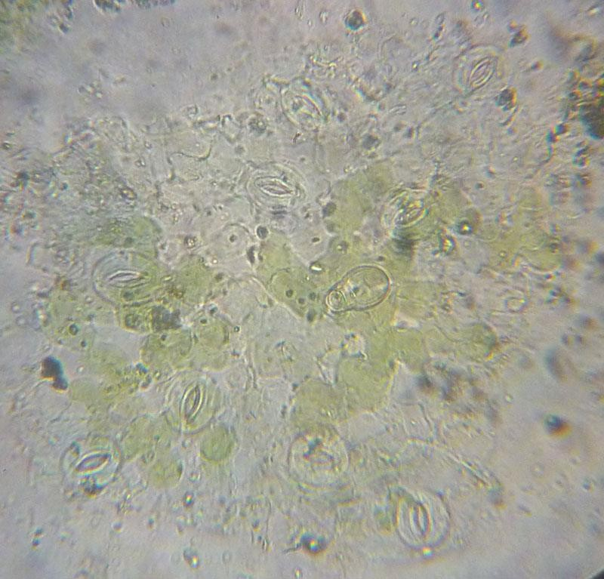
Key Elements
1- Epidermal cell: Wavy wall, diacytic stomata

Slide 13
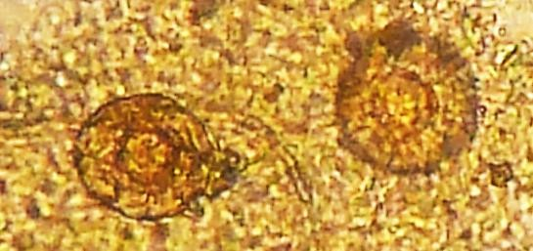
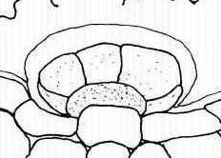
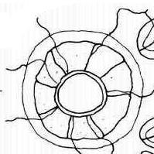
Key Elements
2- hairs:
a- Glandular Hairs:
Labiaceus glandular hair.
Side view
Top view

Slide 14
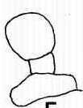
Key Elements
2- hairs:
a- Glangular Hairs: Capitate hair

Slide 15
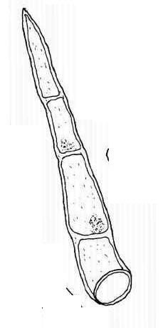
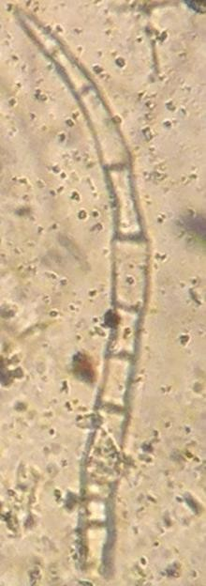
Key Elements
2- hairs:
b- Non- glandular hair

Slide 16



Microscopical Characters:
Mount in KOH: All key elements
Mount in phlourogucinol: Xylem vessels
Mount in water: Labiaceus glandular hair, multicellular Non- glandular hair and capitate hair

Slide 17

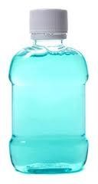
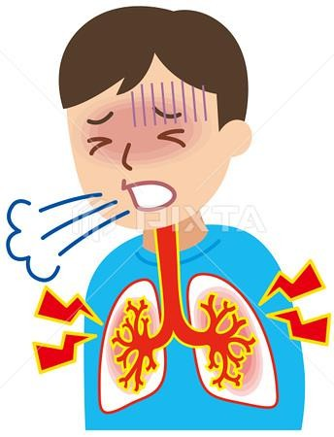
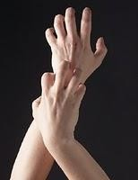
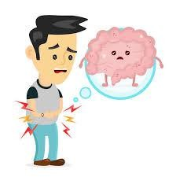
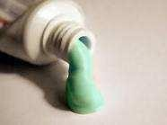
Uses
Used for bronchitis, whooping cough and upper respiratory tract infections.
The oil is used as carminative, antispasmodic
Flavouring agent and antiseptic in mouth washes, toothpaste and creams
Antifungal for skin infection

Slide 18
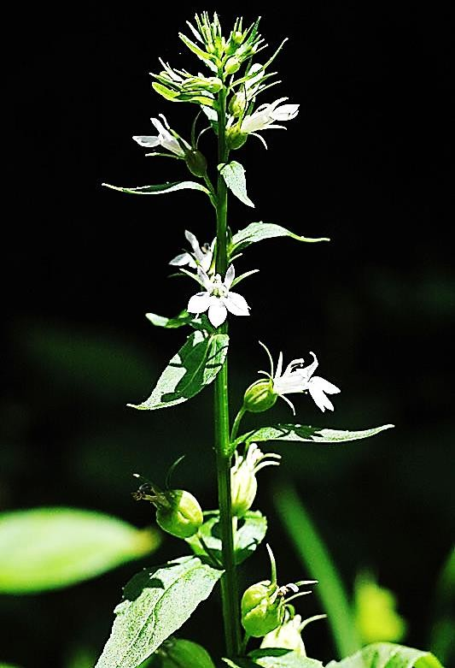
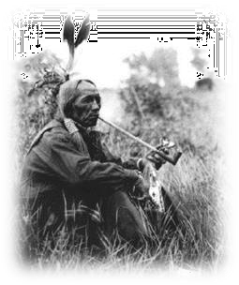
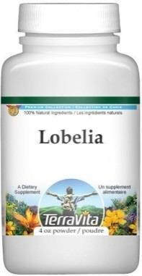
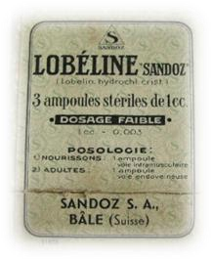
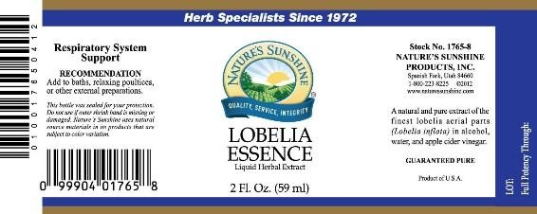
Herbs
2-Lobelia“Indian tobacco”
Origin:
The dried aerial parts of Lobelia inflata Family: Campanulaceae.

Slide 19
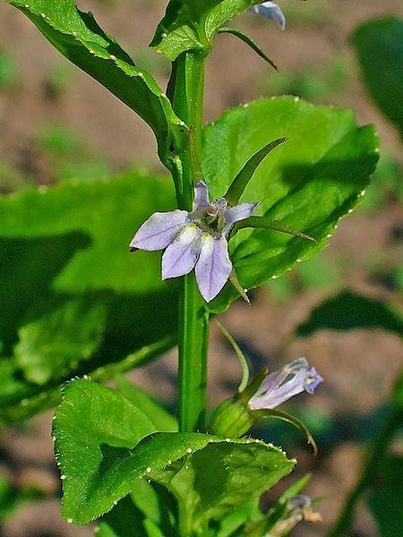
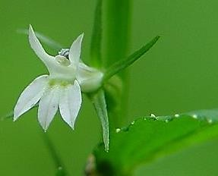
Morphology of stem:
Shape: Winged, hairy
Color: Pale green-light green

Slide 20

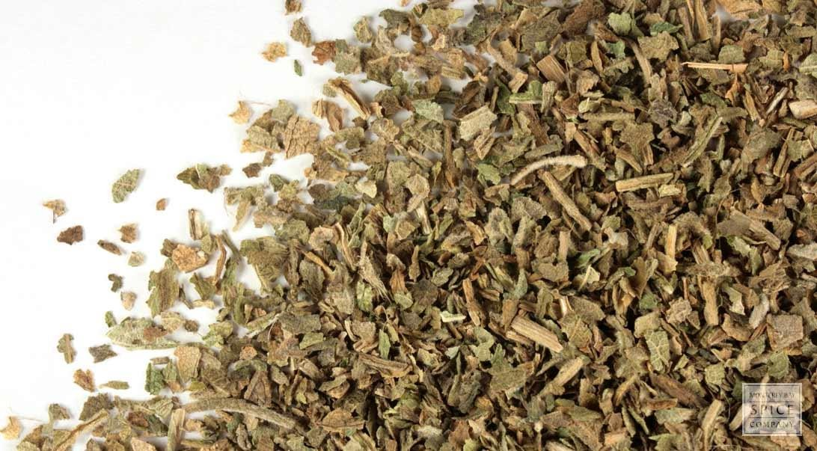
Physical characters:
Condition: Fine powder.
Colour: light Green. Odor: Irritant odor. Taste: Burning acrid.

Slide 21

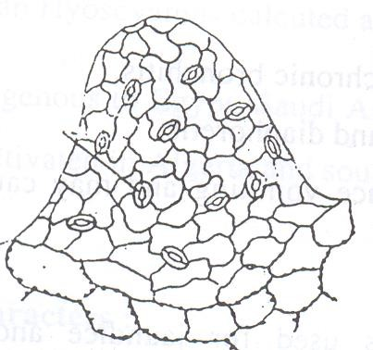
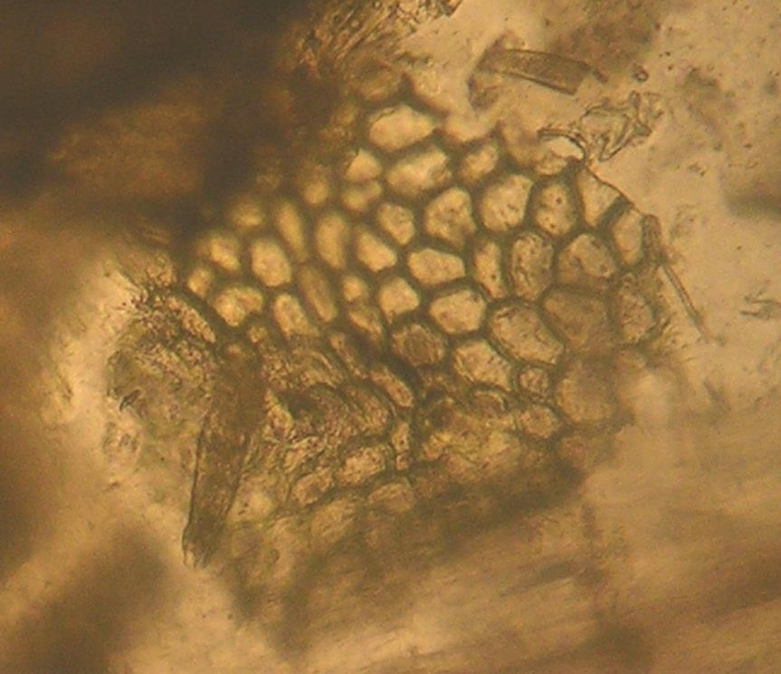
Key Elements
Papillosed cells
Epidermal cells of leaf with anomocytic stomata and beaded anticlinal walls

Slide 22

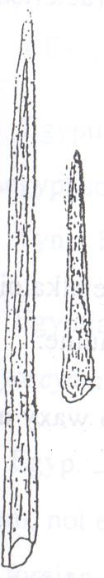
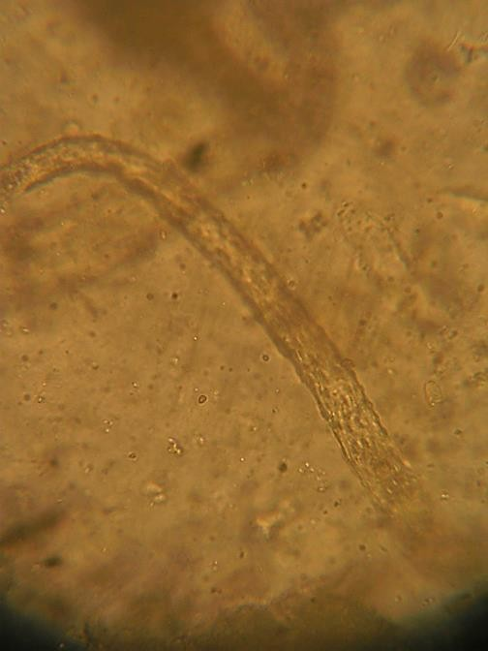
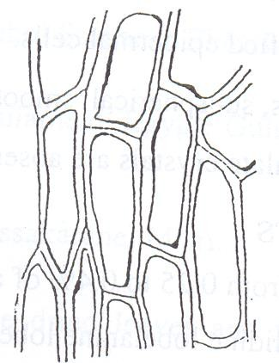
Key Elements
Non glandular hair unicellular with streaked cuticle
Seed coat

Slide 23
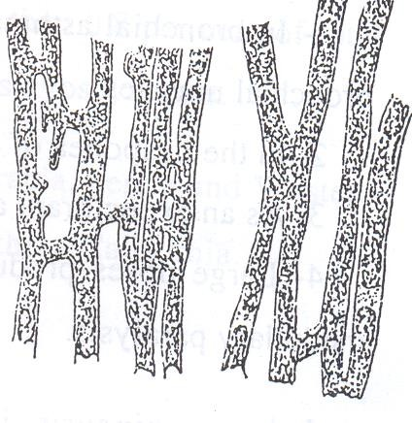
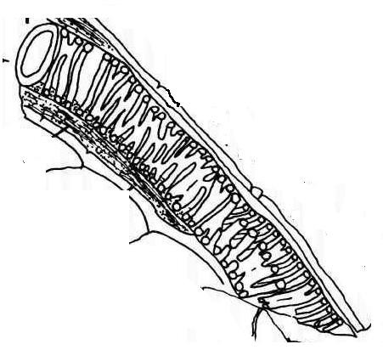
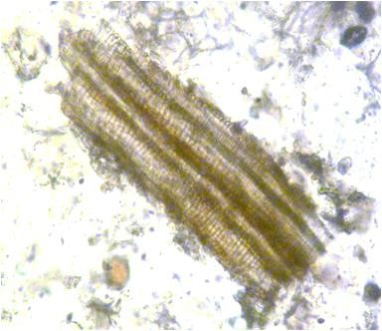
Key Elements
Xylem vessels
Laticeferous vessels contain latex

Slide 24
Microscopical Characters:
Mount in KOH: All key elements
Mount in phlourogucinol: Xylem vessels
Mount in water: Non glandular hair unicellular with streaked cuticle

Slide 25
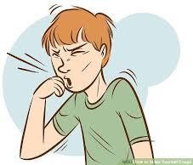
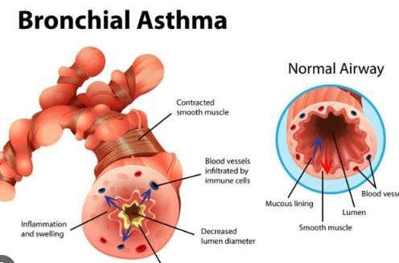

Uses
Expectorant.
An injection of lobeline HCl is used for resuscitation in new born babies.
In bronchitis & bronchial asthma as it dilates the bronchioles.
Breaking of smooking habbit.

Slide 26
References:
Trease& Evans' Pharmacognosy by William Charles Evans, 2002.
Fundamentals of Pharmacognosy and Phytotherapy by Michael Heinrich, Joanne Barnes, SimonGibbons, and Elizabeth M. Williamson, 2004.
Botany : An introduction to Plant Biology, Third edditionby James D. Mauseth,2008.

Slide 27
Useful links:
http://www.hort.purdue.edu/newcrop/med‐aro/default.html
http://www.herbmed.org/ http://www.danish‐schnapps‐recipes.com/plants.html http://www.botanical.com/

Slide 28


